Slide 1
PRESENTATION ON BUILDING WEATHER APP

Slide 2
The team members are: A. Keerthi Priya : 20NM1A0202 B. Pravallika : 20NM1A0208 B. Poojitha : 20NM1A0209 B. Vaschalya : 20NM1A0211

Slide 3
What is innovation ? Lets’s start by defining what innovation is. To me, innovation is the process of creating something new that makes life better . Innovation is impossible without passion. Innovators see the world differently. We see the world as it should be as opposed to seeing the world become real as it is. And we’re entirely restless until we see that better world become real. We are the crazy ones.

Slide 4
Weather app : Knowing what the day will bring is one good way to making a prefect plan for each day. Sometimes this is usually a difficult one for all us because nobody really knows for certain what is likely to happen in the nearest minutes. Even in the area of the weather, this is paramount.

Slide 5
This is the smartphone which is one of the best one in the world and a wonderful product of innovation.

Slide 6
In this system the user can view weather for which they search for.
The system can track local and national weather.
The proposed system uses rapid API for searching the weather.
The proposed system provides the weather of different cities around the world.

Slide 7
WORKING OF THE PROJECT
The user is asked to enter the name of the city.
User then clicks on search which further calls the rapid API.
Weather conditions of place which include Temperature, Humidity, Wind speed, Wind Degree, Cloud PCT are displayed.
If user wishes to search weather for other cities he can re-enter the city name in search bar and press enter.

Slide 8
If users wishes to exit , he can simply close the application.
In this system don’t need to setup weather station in each country to get information. We can get those information including Temperature, Humidity etc. by using weather API.

Slide 9
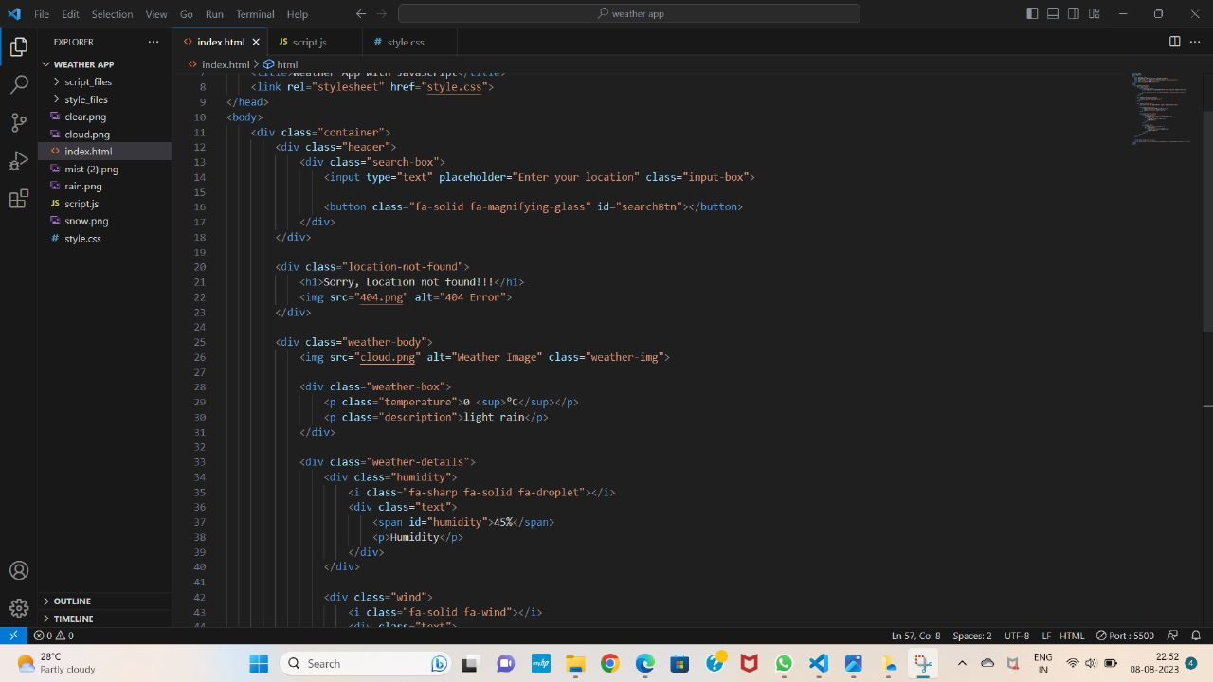
HOW DID WE BUILD WEATHER APP

Slide 10
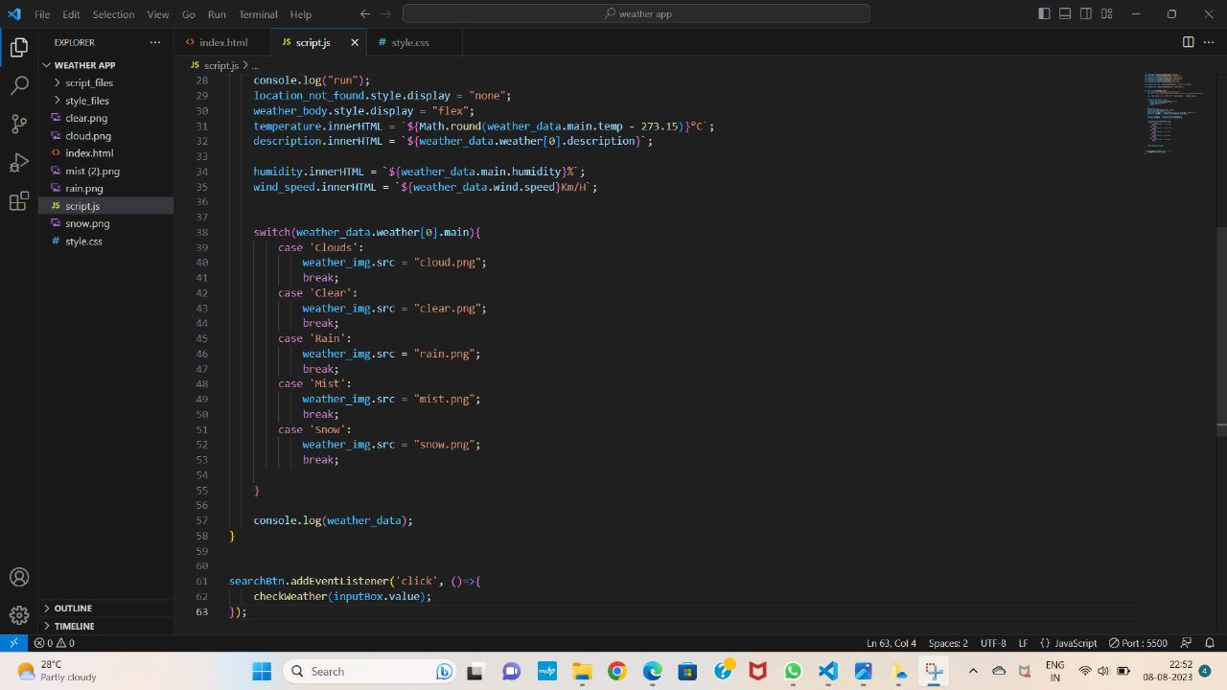

Slide 11
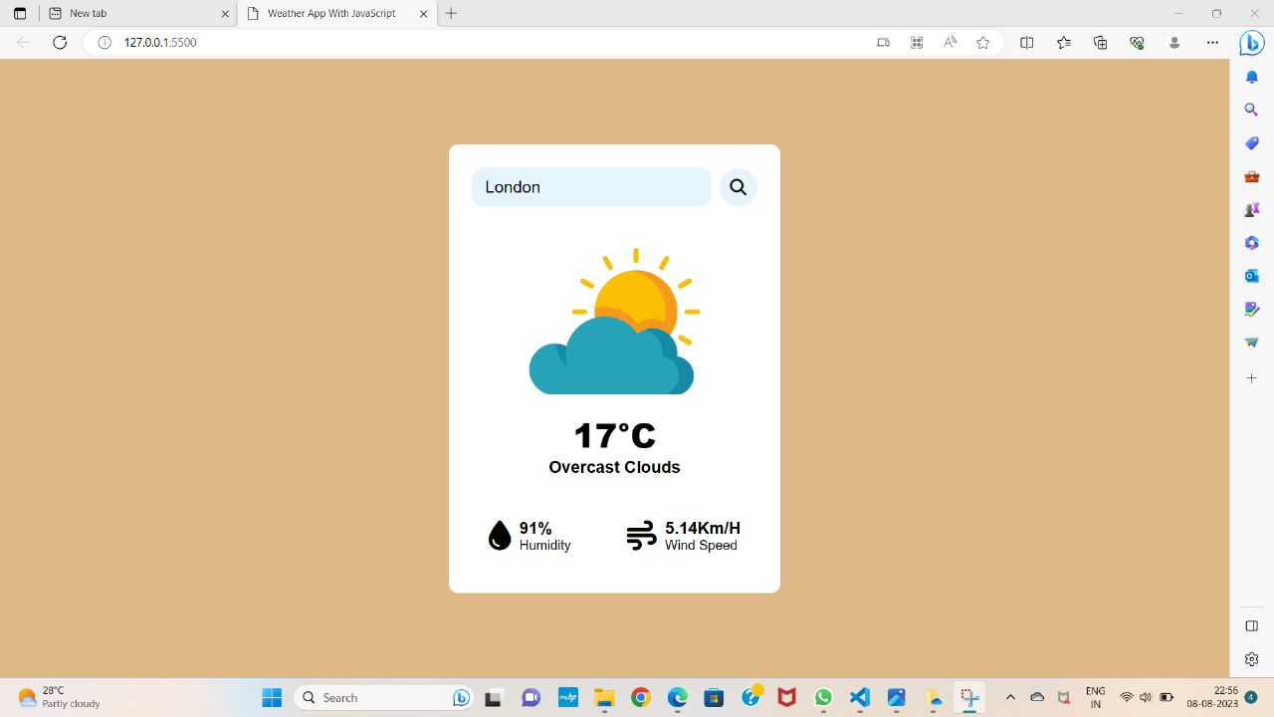
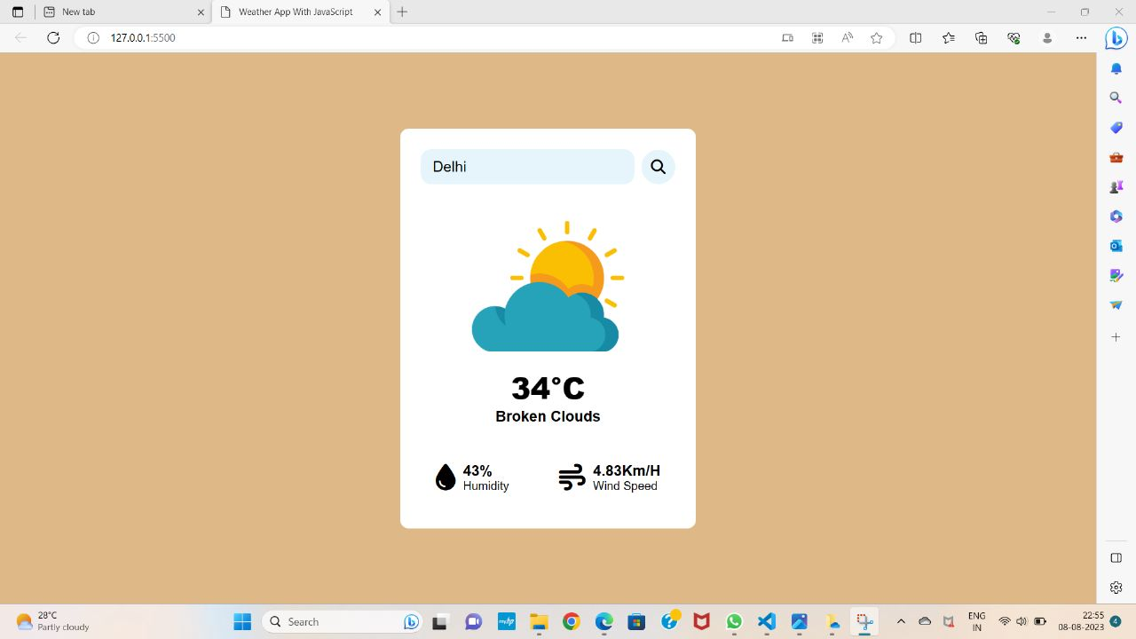

Slide 12
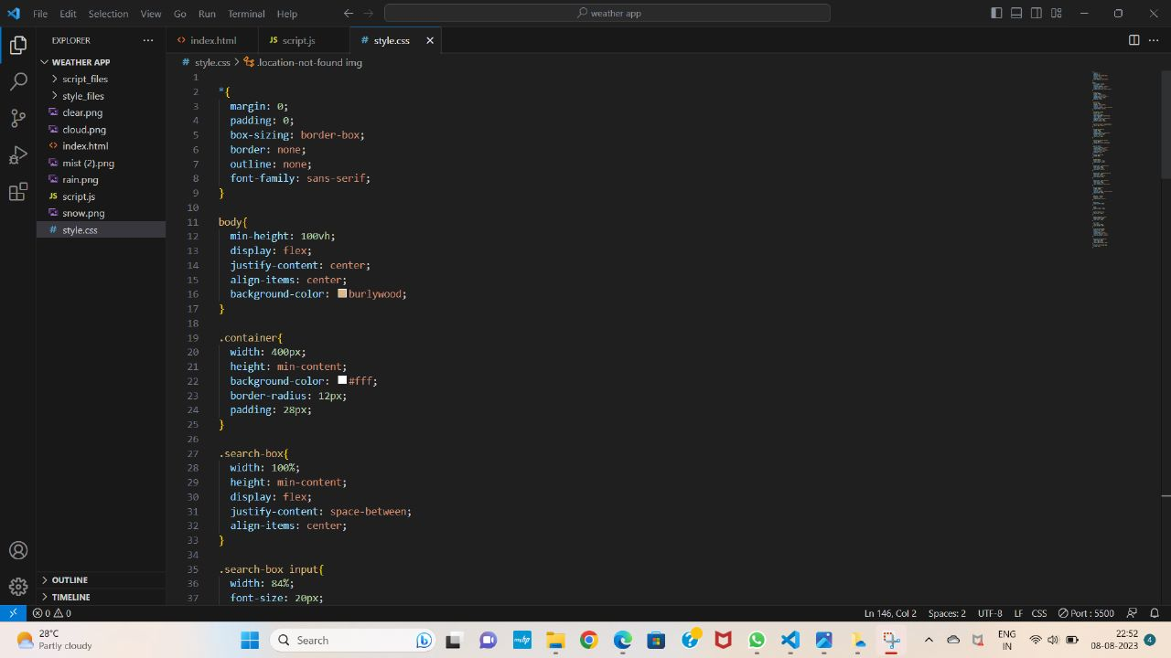

Slide 13
TECHNOLGY USED:
HTML
CSS
Javascript
Framework : Bootstrap
API : Rapid API

Slide 14
DATA SOURCE
our system uses RapidAPI to get the weather information.
RapidAPI the world largest API hub, is used by millions of developer to find,test, and connect tp thousand of API’s.
we are using “Weather by API-Ninja’s from RapidAPI hub.
The back-end of the application uses API from RapidAPI, which is open source and enables anyone to download APIs for various purpose.

Slide 15
BENEFITS
The weather app enables you make better preparation for the day in relation to giving accurate daily weather.
we need Weather App to plan Journeys ahead, To plan meetings/commute timings.
A person travelling in a bus, train or flight may need to check the weather in his destination city.
The system provides you with details of the weather elements Temperature, Wind speed, Humidity, Wind Degrees, precipitation, etc.

Slide 16
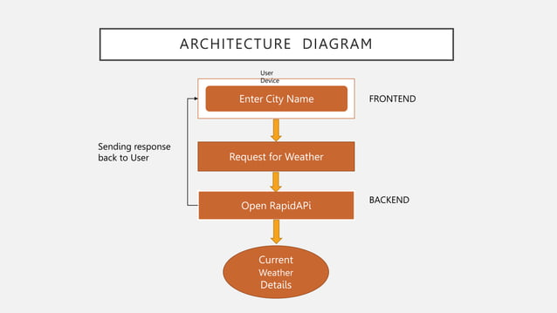
ARCHITECTURE DIAGRAM

Slide 17
THANK YOU

